Slide 1


CAFFEINE INTAKE ANALYSIS
How caffeine consumption relates to focus & sleep
Johnathan Nguyen
Foundations of Data Analytics

Slide 2

DATA OVERVIEW
Dataset Information
  500 Observations, 13 Variables
  Included Caffeine Intake, Focus level, sleep quality, sleep impact, beverage choice, gender, and time of day.
Variables Types
  Numerical: caffeine_mg (scaled), age (scaled 0-1), focus, sleep_quality
  Categorical: beverage types, gender, time of day, sleep impacted
Data Cleaning
  No missing values
  Caffeine Scaled from 0-1 → mg (0-1000 mg)
  Age kept on 0-1 scale but interpreted as approx 0-100 years old
  Data Tidy

Slide 3
INTERESTING STATISTICS & PATTERNS
Key Numerical Insights
  Median Caffeine Intake: 290.9 mg
  Most People Fall between 200-300 mg range
  Sleep Quality Median: 0.64 (Slightly above average)
Interesting Finds
  Age distribution was even across the 0-1 scale
  No extreme outliers
Summary Statistics Helpfullness
  Weak positive correlation between caffeine & focus
  Weak negative correlation between caffeine & sleep
  No gender differences

Slide 4
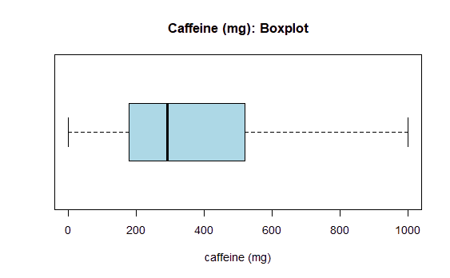
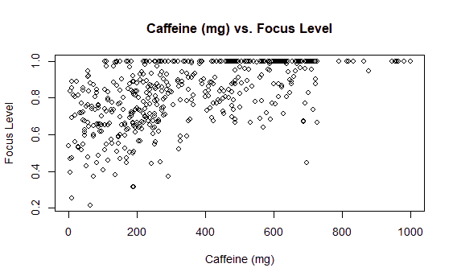
VISUALS & ANALYSIS (1/2)
Caffeine Intake
Box Plot
  Most participants consume 177-518mg
  Some people reached above 800 mg, indicating heaving caffeine use
Caffeine vs Focus
  Slight upward trend
  Weak positive correlation
  More caffeine = slightly better focus

Slide 5
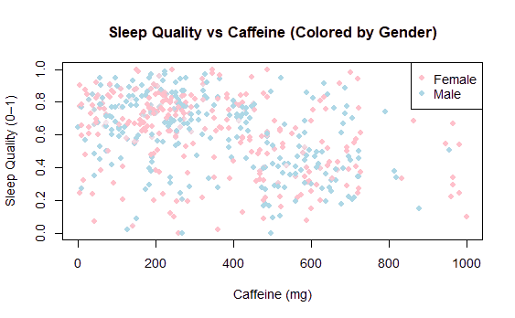
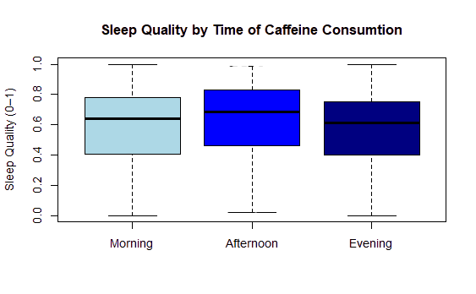
VISUALS & ANALYSIS (2/2)
Sleep Quality vs Caffeine
  Weak Negative Relationship
  As caffeine increases, Sleep quality slightly decreases
  Correlation: -0.36
Sleep Quality by Gender
  Nearly Identical
  Suggests caffeine affects males and females equally
Sleep Quality by Time of Day
  Evening drinkers show lower sleep quality
  Morning/Afternoon consumers have very similiar medians

Slide 6
RESULTS & CONCLUSIONS
Overall Findings
  Caffeine Improves Focus
  Higher Caffeine intake decreases sleep quality
  Gender has no impact
  Time of day shows small differences (evening being the worse)
What didn’t work / Limitations
  Age was scaled (Unknown real ages)
  Correlations were weak
  Self-reported data was possibly biased
Future Work?
  Uses real age values
  Compare based on daily routines
  Explore sleep duration not just quality
Were Questions Answered?
  Found clear trends in focus and sleep
  Trends were weak but consistent

Slide 7
THANK YOU

